Slide 1




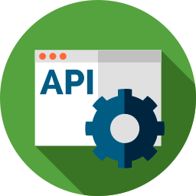






COMPLETE GUIDE TO ASP.NET CORE MVC
BHRUGEN PATEL
www.dotnetmastery.com

Slide 2
TOPICS COVERED
CRUD OPERATIONS
Entity Framework Core
Fundamentals of ASP.NET Core
Client & Server Validations
CHANGES IN .NET 7
MVC/Razor Pages
TempData / Toastr
ERROR SOLVING

Slide 3
Prerequisites
C# (Basics)
SQL
(Basics)

Slide 4
TOOLS NEEDED
.NET 7
VISUAL STUDIO 2022
SSMS 2018

Slide 5
TOPICS COVERED
CRUD OPERATIONS
Entity Framework Core
Fundamentals of ASP.NET Core
Client & Server Validations
CHANGES IN .NET 6
DEPLOY TO AZURE
TempData
ERROR SOLVING

Slide 6
.NET CORE ROADMAP
.NET CORE
1.0
2.0
3.0
5.0
.NET CORE
.NET CORE
.NET CORE
.NET CORE
.NET CORE
6.0
7.0
June 2016
Aug 2018
Sept 2019
Nov 2020
Nov 2021
Nov 2022

Slide 7
BUILT IN DEPENDENCY INJECTION
CROSS PLATFORM
EASY UPDATES
ASP.NET CORE
FAST AND OPEN SOURCE
CLOUD FRIENDLY
PERFORMANCE

Slide 8
Projects
CRUD MVC
CRUD Razor Pages
MVC - ECommerce

Slide 9
Course Overview
N-Tier Architecture
Repository Pattern and UnitOfWork
TempData/ViewBag/ViewData in .NET core
API Controllers with Razor Pages
SweetAlerts, Rich Text Editor and DataTables with .NET Core
Scaffold Identity (Razor Class Library)
Roles and Authorization in .NET Core
Stripe Payment/Refund with .NET Core
Session in .NET Core
Emails with SendGrid
User Management
Social Login using Facebook
View Components in .NET Core
Seed Database with DbInitializer
Deploy to Azure

Slide 10
TOPICS COVERED
Entity Framework Core
CRUD OPERATIONS
Fundamentals of ASP.NET Core
EMAIL TEMPLATES
SESSION, VIEWDATA, VIEWBAG, VALIDATIONS
ADD IDENTITY TO PROJECT
ASSIGNMENTS , ERROR SOLVING

Slide 11
TOPICS COVERED
CRUD OPERATIONS
Entity Framework Core
Fundamentals of ASP.NET Core
Client & Server Validations
CHANGES IN .NET 6
DEPLOY TO AZURE
TempData
ERROR SOLVING

Slide 12
ALTERNATIVE RESOURCES

Slide 13
TOPICS COVERED
Mercury
Venus
Saturn
Mars
Jupiter
Neptune
Mercury is the closest planet to the Sun
Venus is the second planet from the Sun
Saturn is the ringed one and a gas giant
Despite being red, Mars is a cold place
It’s the biggest planet in the Solar System
Neptune is the farthest planet from the Sun

Slide 14
Section 2 - Architecture

Slide 15
DEPENDENCY INJECTION

Slide 16



WITHOUT DEPENDENCY INJECTION
Page 1
Db dbObj = new Db()
Email
Email emailObj = new Email()
Page 2
Email emailObj = new Email()
Db dbObj = new Db()
Page 3
Database
Email emailObj = new Email()
Db dbObj = new Db()

Slide 17
WITH DEPENDENCY INJECTION
Page 1
IDb
Email
IEmail
IEmail,Email
IEmail
Page 2
DI
CONTAINER
IDb
IDb,Db
Page 3
IEmail
Database
IDb

Slide 18



.NET CORE PIPELINE
Request from Browser
Auth
MVC
Static Files

Slide 19
ASSIGNMENT - 1
Push Product to Database
Implement Product Repository
Configure Product Repository in UnitOfWork.

Slide 20
ASSIGNMENT - 2
Create Product Controller & Action Methods (Create/Edit/Delete/Index)
Create Views for Create/Edit/Delete/Index
Add Client Side and Server-Side Validations.

Slide 21
ASSIGNMENT - 3
Create Company Model / Table
Id [Key]
Name [Required]
StreetAddress
City
State
PostalCode
PhoneNumber
Add Company to Repository and UnitOfWork
Perform CRUD Operations on Company (using DataTables)

Slide 22
ASSIGNMENT
Add logic to remove item from shopping cart.
Add logic to decrement count in shopping cart for item. (If count is 1 then you will have to remove)

Slide 23
ASSIGNMENT
Add OrderHeader and OrderDetails to Database
Add Order Header and Details Repository and Configure UnitOfWork (With Update method)

Slide 24
ASSIGNMENT
Create a new Folder in Pages – Order
In that new folder create new Razor Page – OrderList
Create OrderController and its GET Method should only be invoked by authorized user.
GET Method in controller should return all OrderHeaders.

Slide 25
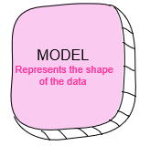
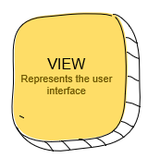
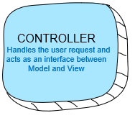
MVC ARCHITECTURE
2. Get Data
3. Get Presentation
USER CLICKS
1. Request
4. Response

Slide 26
ROUTING IN MVC
The URL pattern for routing is considered after the domain name.
https://localhost:55555/Category/Index/3
https://localhost:55555/{controller}/{action}/{id}
URL | Controller | Action | Id
https://localhost:55555/Category/Index | Category | Index | Null
https://localhost:55555/Category | Category | Index | Null
https://localhost:55555/Category/Edit/3 | Category | Edit | 3
https://localhost:55555/Product/Details/3 | Product | Details | 3

Slide 27
ENDPOINTS
https://localhost:1234/Home/Index
/{controller}/{action}
MVC
https://localhost:1234/Home/Login
RAZOR PAGES
https://localhost:1234/Hub/Pop
SIGNALR

Slide 28
.NET CORE PIPELINE
Request from Browser
UseRouting
MVC
Static Files

Slide 29
APPSETTINGS.JSON
All of the application’s settings are contained in a file named as appsettings.json
Any changes to the appsettings.json file will require restarting the “Microsoft IIS Administration” service to take effect.

Slide 30
TAG HELPERS
Tag Helpers are introduced with ASP.NET Core
Tag Helpers enable server-side code to participate in creating and rendering HTML elements in Razor files.
Tag helpers are a new feature and similar to HTML helpers, which help us render HTML.
They are more focused around HTML tags and much more easier to use with HTML.

Slide 31
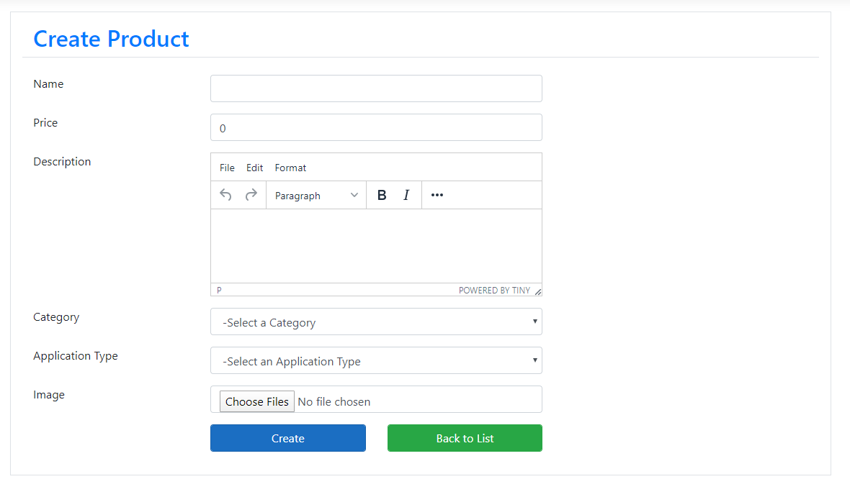
PRODUCT
CATEGORY
APPLICATIONTYPE

Slide 32
Tag Helpers
Tag Helpers are introduced with ASP.NET Core.
Tag Helpers enable server-side code to participate in creating and rendering HTML elements in Razor files.
Tag Helpers are very focused around the html elements and much more natural to use.

Slide 33
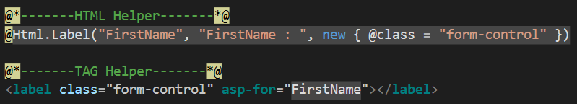
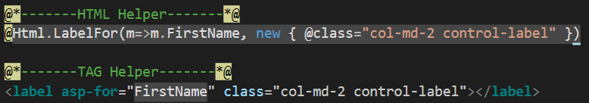
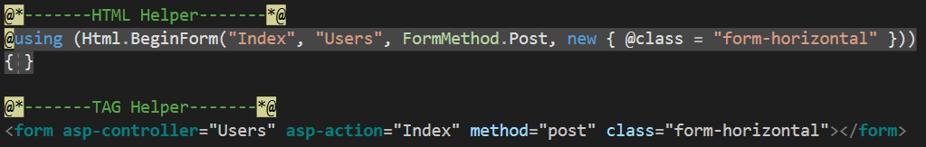

Tag Helpers Example

Slide 34
Razor Pages
Introduced in asp.net core 2.0
Razor Pages is a new feature of ASP.NET Core MVC that makes coding page-focused scenarios easier and more productive
Razor pages is not just for simple scenarios, everything that you can do with MVC you can do by using Razor pages like Routing, Models, ActionResult, Tag Helpers and so on.

Slide 35

Routing in Razor Pages
Routing in Asp.net Razor pages maps URL’s to Physical file on disk.
Razor pages needs a root folder.
Index.cshtml is a default document
URL | Maps To
www.domain.com | /Pages/Index.cshtml
www.domain.com/index | /Pages/Index.cshtml
www.domain.com/account | /Pages/account.cshtml /Pages/account/index.cshtml

Slide 36
Action Result
ActionResult is a result of action methods/pages or return types of action methods/page handlers
Action result is a parent class for many of the derived classes that have associated helpers.
The IActionResult return type is appropriate when multiple ActionResult return types are possible in an action.

Slide 37
Action Result in Razor Pages
ActionResult | Helper | Description
ContentResult | Content | Takes a string and returns it with a text/plaincontent-type header by default. Overloads enable you to specify the content-type to return other formats such as text/html or application/json, for example.
FileContentResult | File | Returns a file from a byte array, stream or virtual path.
NotFoundResult | NotFound | Returns an HTTP 404 (Not Found) status code indicating that the requested resource could not be found.
PageResult | Page | Will process and return the result of the current page.
PartialResult | Partial² | Returns a Partial Page.
RedirectToPageResult | RedirectToPage RedirectToPagePermanent RedirectToPagePreserveMethod RedirectToPagePreserveMethodPermanent | Redirects the user to the specified page.
ViewComponentResult |  | Returns the result of executing a ViewComponent.

Slide 38
Action Result in MVC
Action Result | Helper Method | Description
ViewResult | View | Renders a view as a Web page.
PartialViewResult | PartialView | Renders a partial view, which defines a section of a view that can be rendered inside another view.
RedirectResult | Redirect | Redirects to another action method by using its URL.
RedirectToRouteResult | RedirectToAction RedirectToRoute | Redirects to another action method.
ContentResult | Content | Returns a user-defined content type.
JsonResult | Json | Returns a serialized JSON object.
JavaScriptResult | JavaScript | Returns a script that can be executed on the client.
FileResult | File | Returns binary output to write to the response.
EmptyResult | (None) | Represents a return value that is used if the action method must return a null result (void).

Slide 39
PRODUCT
CATEGORY
APPLICATIONTYPE

Slide 40
VIEWBAG
VIEWDATA
TEMPDATA
ViewBag transfers data from the Controller to View, not vice-versa. Ideal for situations in which the temporary data is not in a model.
ViewBag is a dynamic property that takes advantage of the new dynamic features in C# 4.0
Any number of properties and values can be assigned to ViewBag
The ViewBag's life only lasts during the current http request. ViewBag values will be null if redirection occurs.
ViewBag is actually a wrapper around ViewData.
ViewData transfers data from the Controller to View, not vice-versa. Ideal for situations in which the temporary data is not in a model.
ViewData is derived from ViewDataDictionary which is a dictionary type.
ViewData value must be type cast before use.
The ViewData's life only lasts during the current http request. ViewData values will be null if redirection occurs.
TempData can be used to store data between two consecutive requests.
TempData internaly use Session to store the data. So think of it as a short lived session.
TempData value must be type cast before use. Check for null values to avoid runtime error.
TempData can be used to store only one time messages like error messages, validation messages.
ViewBag internally inserts data into ViewData dictionary. So the key of ViewData and property of ViewBag must NOT match

Slide 41
STRONGLY TYPED VIEWS

Slide 42
VIEWMODELS

Slide 43
ASSIGNMENT
Add Application Type to Product Model.
Add that in all CRUD operations of Product as well

Slide 44
Pending
ORDER STATUS MANAGMENT
Submitted
In Process
Automatic /
Payment Successful
When order is
being cooked
When order is
Ready for Pickup
Ready for Pickup
When order is
Picked Up.
Completed
KITCHEN
MANAGER
KITCHEN
MANAGER
FRONT DESK
MANAGER
Submitted
In Process
FRONT DESK
MANAGER
Cancel or Refund order
Manage Order
Refund / Cancel
Ready For Pickup
Completed
Cancelled
Order List

Slide 45

ORDER STATUS MANAGMENT
Makes Payment
Order Confirmation
Processing
Shipped
Individual
Customer
Status - Pending
Payment - Pending
Status - Approved
Payment - Approved
Status - Processing
Payment - Approved
Status - Shipped
Payment - Approved

Slide 46
ORDER STATUS MANAGMENT
Makes Payment
Order Confirmation
Processing
Shipped
Customer
Status - Pending
Payment - Pending
Status - Approved
Payment - Approved
Status - Processing
Payment - Approved
Status - Shipped
Payment - Approved
Order Confirmation
Processing
Makes
Payment
Shipped
Company have 30days
to make payment
after order is shipped
Company
Status - Approved
Payment - ApprovedForDelayedPayment
Status - Processing
Payment - ApprovedForDelayedPayment
Status - Shipped
Payment - ApprovedForDelayedPayment
Status - Shipped
Payment - Approved

Slide 47
VIEWMODEL
ViewModel contain fields that are represented in the view
ViewModel can have specific validation rules using data annotations.
ViewModel can have multiple entities or objects from different data models or data source.
ViewModel helps to implement strongly typed views.

Slide 48
VIEWBAG
ViewBag transfers data from the Controller to View, not vice-versa. Ideal for situations in which the temporary data is not in a model.
ViewBag is a dynamic property that takes advantage of the new dynamic features in C# 4.0
Any number of properties and values can be assigned to ViewBag
The ViewBag's life only lasts during the current http request. ViewBag values will be null if redirection occurs.
ViewBag is actually a wrapper around ViewData.
ViewData transfers data from the Controller to View, not vice-versa. Ideal for situations in which the temporary data is not in a model.
ViewData is derived from ViewDataDictionary which is a dictionary type.
ViewData value must be type cast before use.
The ViewData's life only lasts during the current http request. ViewBag values will be null if redirection occurs.
TempData can be used to store data between two consecutive requests.
TempData internaly use Session to store the data. So think of it as a short lived session.
TempData value must be type cast before use. Check for null values to avoid runtime error.
TempData can be used to store only one time messages like error messages, validation messages.
ViewBag internally inserts data into ViewData dictionary. So the key of ViewData and property of ViewBag must NOT match

